Slide 1
Chapter 9: Multiple Linear Regression
Return to cereals data. Previously, used simple linear regression to fit relationship between nutritional rating (target or response variable) and sugars (predictor or explanatory variable). But there were other possible explanatory variables in the dataset:
name | calories | protein | fat | sodium | fiber | carbo | sugars | rating
100% Bran | 70 | 4 | 1 | 130 | 10 | 5 | 6 | 68.402973
100% Natural Bran | 120 | 3 | 5 | 15 | 2 | 8 | 8 | 33.983679
All-Bran | 70 | 4 | 1 | 260 | 9 | 7 | 5 | 59.425505
All-Bran with Extra Fiber | 50 | 4 | 0 | 140 | 14 | 8 | 0 | 93.704912
Almond Delight | 110 | 2 | 2 | 200 | 1 | 14 | 8 | 34.384843
Apple Cinnamon Cheerios | 110 | 2 | 2 | 180 | 1.5 | 10.5 | 10 | 29.509541

Slide 2
Multiple Regression Model Building
Models set of predictors to single response (continuous quantitative variable)
Provide improved precision for estimation and prediction
Model uses plane or hyper-plane to approximate relationship between predictor set and single continuous response
Predictors typically continuous; but can include categorical predictors via indicator (dummy) variables.

Slide 3
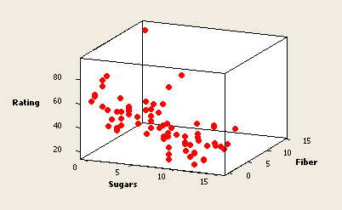

Example: nutritional rating on sugars and fiber
Scatterplot in 3 dimensions. Find best-fitting plane to data.
High fiber level associated with high rating
High sugar level associated with low rating
Fitted Model:

Slide 4
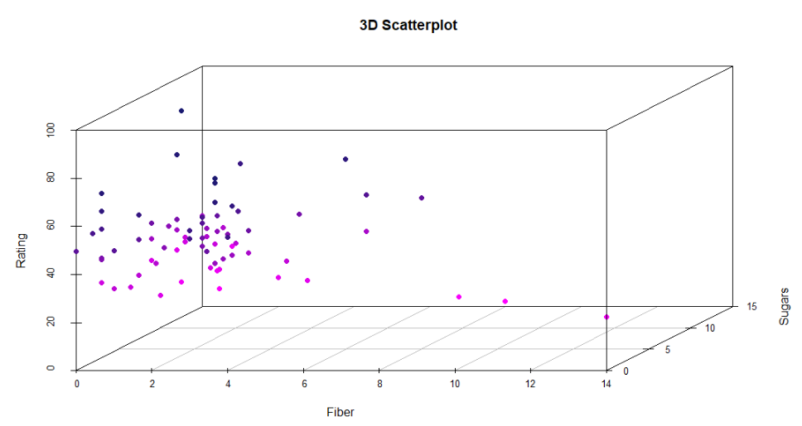
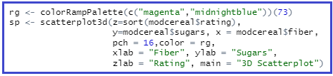
3D Plot of Data

Slide 5
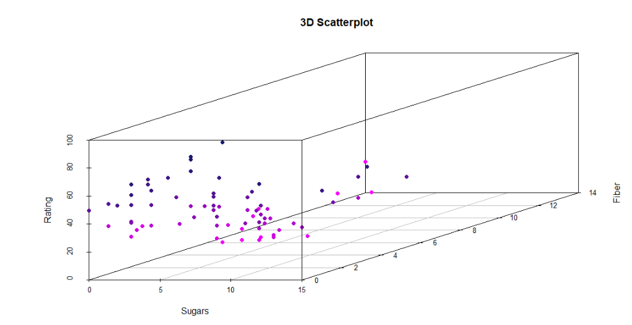
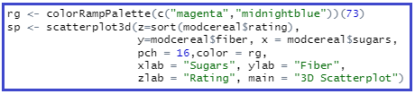
3D Plot of Data

Slide 6
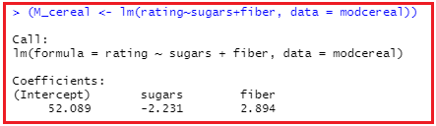

Using R to fit the model
Cleaned up data: modcereal – removed NA’s so that I have complete cases. (Only one NA removed.)
(M_cereal <- lm(rating~sugars+fiber, data = modcereal))

Slide 7
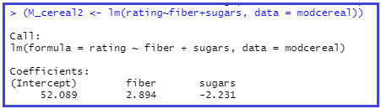
Does it matter which predictor you enter into the command first?

